Slide 1
VISTAAR CSR Project Overview
Samarpaka Seva Trust
(A not-for-profit bridging platform)

Slide 2
Relationship diagram:
NGO
organ
i
z
t
i
ons
Process flow diagram depicts the actual process of the project execution after the acceptance of the donor until the project execution and closure with the project and impact assessment reports
VISTAR - DONOR Organization
SST – Bridging platform
Process flow diagram:
NGO
organ
i
za
t
i
ons
VISTAR - DONOR Organization
Fund flow line
Relationship diagram is to depict the broad relationship between the Donor, Donnie and the bridging platform SST. All the service organizations are contacted for funds through SST and SST intern put up proposals accordingly for donors’ acceptance
Information flow
SST – Bridging platform
Execution follow-up
PMC charges reimbursed by NGOs to SST

Slide 3
Services offered:
Corporate Services
NGO Services
Shared Services
Customized CSR strategies, aligned with vision, philosophy, expertise, stakeholder expectations
Promotion of Corporate CSR activities as per the requirements and create social visibility
Project implementation and management on behalf of corporates
Document and reporting
Corporate volunteer engagement
Champion the overall partnership
Work with network NGOs across India to bring access to funding, partnerships with corporates, best practices
Plan and execute campaigns
Project execution support to NGOs, by bringing in best practices to NGOs
Prepare relevant and particular statistics – charts/highlights/success stories/testimonials/opinions/lessons learnt etc.
Share and spread the expertise and best practices across organizations
Guide to achieve benchmarks in operations, execution and results
Leverage and create multiplier effect
Impact assessments and research

Slide 4
Reporting / Responsibility chart :
Subject flow of the project | Action responsibility
Finalization of contract | VISTAAR, SST, NGO
Contract acceptance and submission of project plan | SST, NGO
Kick-off of the project | All three organizations
Execution as per the plan submitted | NGO, SST
Project Management and reporting | SST, NGO
Review progress (quarterly once) | All three organizations
Documentation, evidence, testimonials and review | SST , NGO, VISTAAR
Project plan further follow up until closure | SST,NGO
Closure of the project, reporting and impact assessment reports | All three organizations

Slide 5
Project Disciplines
15+
Active Projects
Children & Education
Health & Wellness
Environment & Sanitary projects
10+
Impact
Areas
Specially Enabled
Women
Welfare
Family Counselling
Rural Welfare
12+
Partner
NGOs
Vocational Training
Volunteering
Tribal Development
10K+
Beneficiaries

Slide 6
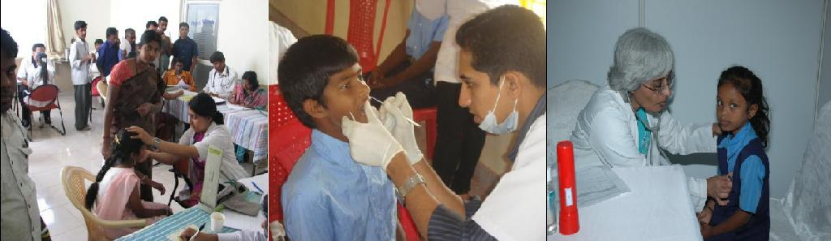
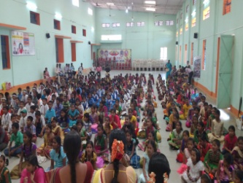
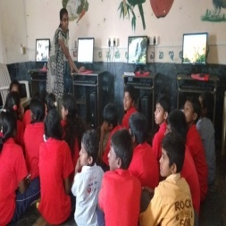
projects – In Brief
Health & Wellness
School Health Program & Health Camps
Rural Welfare Project
Seva Mitra
Inclusivity of rural people to become self-reliant and socially responsible citizens
Health screenings focus on multiple fronts: Eye, Dental, Heart.
Holistic development of rural people by creating a daily support eco system.
Strong involvement of volunteer doctors
Completion of the checkup cycle by guiding children through to treatment
Education & Youth Development, Health Awareness, Environmental Awareness, Women Empowerment
Health Awareness drives to complement checkups
6 Taluks and 108 Panchayats in Rural Karnataka
Annual Budget
Rs.
Annual Budget
Rs. 84 Lakhs
Outside Karnataka ?
Yes, can be replicated at any given location
Outside Karnataka ?
Yes in Maharashtra, Assam

Slide 7
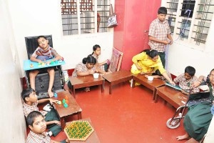
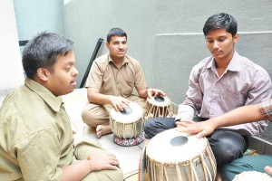
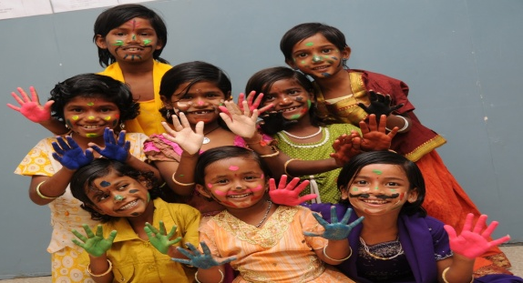
projects – In Brief
Specially Abled
Divyaang
Education & Children
Home for Destitute Children - Nele
Pre-School Education Program, sensory Integration & Behavior modification, formal and non-formal education
Rehabilitation Center for Homeless Children
Most of the children from economically and socially backward backgrounds. Complete education free of cost.
Holistic Development of the child - Education, Health, Food, Cultural, Sports, Counseling
Activities to enhance & strengthen emotional and spiritual development.
Supports to pursue higher education based on child talent & interest.
Training – Vocational & Rehabilitation
Care givers training
Annual Budget
Rs. 90 Lakhs
Annual Budget
Rs. 110 Lakhs
Outside Karnataka ?
Yes in Andhrapradesh, Tamilnadu, Delhi, Odisha
Outside Karnataka ?
No.

Slide 8
Proposed projects and segments are for your review but not exhaustive. further details will be provided as needed

